Slide 1
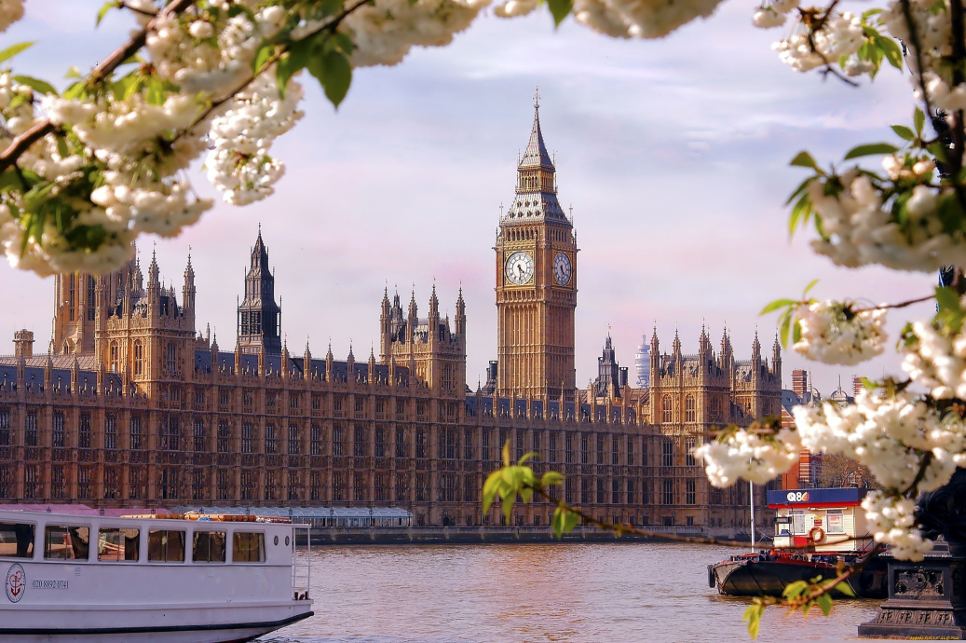
Косвенная речь. Согласование времен. 8класс
Учитель иностранного языка МОУ ИРМО Хомутовская СОШ № 1 - Шустова Инна Аркадьевна

Slide 2
Обратите внимание!!!
В английском языке, при переводе из прямой речи в косвенную, если глагол , который вводит прямую речь употребляется в Past Simple происходит согласование времен!!!
В предложениях происходят следующие изменения:

Slide 3
Запомни!!!
1) John said: "I live in New York."
John said (that) he lived in New York.
Bob said: "I can't swim."
Bob said he couldn't swim.
2) Bob said: "I am learning French."
Bob said he was learning French.
We said to Tom: "We are leaving soon."
We told Tom we were leaving soon.
Present simple переходит в →Past simple
Present progressive переходит в → Past progressive

Slide 4
Запомни!!!
3)Ann said: "Jack went home."
Ann said Jack had gone home.
Ann said to Helen: "I bought a good book."
Ann told Helen she had bought a good book.
Fred said: "I have done it."
Fred said he had done it.
Jill said to Ann: "I have made tea."
Jill said to Ann she had made tea.
Past simple переходит в → Past perfect
Present perfect переходит в → Past perfect

Slide 5
Let’s train!
What did they say? Report it.
1) Julia said: “My seats are in the stalls.”
Julia said her seats were in the stalls.
2) Ben said: “I am in the cloakroom.”
Ben said he was in the cloakroom.

Slide 6
3) Tony said: “The play is interesting.”
Tony said the play was interesting.
4) Peter said: “We are near the orchestra pit.”
Peter said they were near the orchestra pit.
5) Jane said: “I live in London.”
Jane said she lived in London.

Slide 7
6) Sarah said: “I have a good collection of books at home.
Sarah said she had a good collection of books at home.
7) Bob said: “I can do it.”
Bob said he could do it.
8) Tom said: “We are organizing a coffee break.”
Tom said they were organizing a coffee break.

Slide 8
9) Terry said: “I am offering you a cup of tea.”
Terry said she was offering me a cup of tea.
10) Jim said: “I am connecting the two lines.”
Jim said he was connecting the two lines.

